Slide 1
E-business strategy
What is e-business strategy?
Strategic analysis
Strategic objectives
Strategy definition

Slide 2
Introduction
Strategy defines the future direction and actions of an company /organization or part of an organization as approaches to achieve specific objectives.
the direction and scope of an organization over the long-term: which achieves advantage for the organization through its configuration of resources within a changing environment to meet the needs of markets and to fulfil stakeholder expectations.
E-business strategies share much in common with corporate, business and marketing strategies. These quotes summarizing the essence of strategy could equally apply to each strategy:
  ‘Is based on current performance in marketplace.’
  ‘Defines how we will meet our objectives.’
  ‘Sets allocation of resources to meet goals.’
  ‘Selects preferred strategic options to compete within a market.’
  ‘Provides a long-term plan for the development of the organization.’
  ‘Identifies competitive advantage through developing an appropriate positioning defining a value proposition delivered to customer segments.’

Slide 3
E-business Strategy
E-business strategy Definition of the approach by which applications of internal and external Electronic communications can support and influence corporate strategy.
organizations have different levels of strategy, particularly for larger or global organizations. These are summarized within Figure 5.1. They identify
corporate strategy which is concerned with the overall purpose and scope of the organization,
business unit strategy which defines how to compete successfully in a particular market and
operational strategies which are concerned with achieving corporate and business unit strategies.
Additionally, there are what can be described as functional strategies that describe how the corporate and business unit strategies will be operationalized in different functional areas or business processes.
Functional or process strategies refer to marketing, supply chain management, human resources, finance and information systems strategies.
Notes:
In essence, operational strategy is more company-wide, focusing on competition and overall business operations, while functional strategy is implemented at the departmental level, covering specific business tasks and the skills of employees

Slide 4
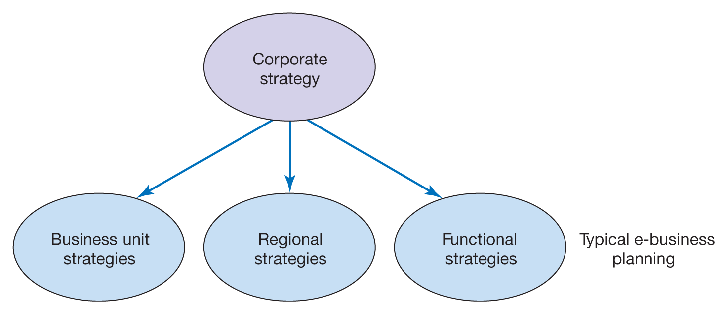
Figure 5.1 Different forms of organizational strategy

Slide 5
Management issues
How does e-business strategy differ from traditional business strategy?
How should we integrate e-business strategy with existing business and IS strategy?
How should we evaluate our investment priorities and returns from e-business?
Notes:
How does e-business strategy differ from traditional business strategy?
E-business strategy differs from traditional business strategy in several ways. Firstly, e-business strategy focuses on the use of digital technologies and the internet to conduct business activities and reach customers, whereas traditional business strategy revolves around more conventional methods.Secondly, e-business strategy places a greater emphasis on data analytics and digital marketing techniques to understand customer behavior and improve online visibility. Traditional business strategy, on the other hand, may rely more on market research and traditional advertising methods.Additionally, e-business strategy often involves lower overhead costs, as it eliminates the need for physical stores or extensive physical infrastructure. Conversely, traditional business strategy may require substantial investments in physical assets.Furthermore, e-business strategy enables global reach, allowing businesses to cater to customers worldwide, whereas traditional business strategy typically focuses on a local or regional customer base.Lastly, e-business strategy requires continuous adaptation to changing technological trends and customer preferences, as digital landscapes evolve rapidly. Traditional business strategy, while also subject to some changes, may have a more stable framework based on established practices.Overall, e-business strategy leverages digital technologies and online platforms to transform and enhance various aspects of traditional business strategy.
2. How should we integrate e-business strategy with existing business and IS strategy?
Integrating e-business strategy with existing business and IS strategy involves aligning digital initiatives with overall business goals and leveraging information systems effectively. Here are some steps to consider:1. Define objectives: Clearly articulate your e-business goals and how they align with your overall business strategy and IS strategy. Identify the specific outcomes you aim to achieve through e-business.2. Assess capabilities: Evaluate your existing business and IS capabilities to identify strengths, weaknesses, and gaps related to e-business. Determine if your current IS infrastructure can support e-business initiatives or if upgrades are required.3. Identify opportunities: Analyze market trends, customer preferences, and potential technological advancements to identify e-business opportunities that can provide a competitive advantage. Consider how e-business can enhance customer experience, increase operational efficiency, or drive innovation.4. Develop a roadmap: Create a well-defined roadmap for integrating e-business with your existing business and IS strategy. Specify the initiatives, investments, and timelines required. Prioritize the steps based on feasibility, impact, and resource availability.5. Collaborate across teams: Foster collaboration between your e-business, business, and IS teams. Encourage open communication and knowledge sharing to ensure that e-business initiatives are seamlessly integrated into the existing processes and information systems.6. Enhance customer engagement: Utilize e-business to enhance customer engagement and satisfaction. Leverage digital channels to provide personalized and seamless experiences, such as online shopping, customer self-service portals, or targeted marketing campaigns.7. Secure data and systems: Ensure robust cybersecurity measures are in place to protect customer data, transactions, and intellectual property. Implement reliable backup, disaster recovery, and data privacy practices to guarantee operational continuity and compliance.8. Monitor and adjust: Continuously monitor and evaluate the effectiveness of your e-business strategy. Collect and analyze data to measure key performance indicators and make necessary adjustments to optimize outcomes.Remember, the successful integration of e-business strategy with existing business and IS strategy requires ongoing adaptation to evolving technology, market conditions, and customer expectations.
3. How should we evaluate our investment priorities and returns from e-business?

Slide 6
E-channel strategies
E-channel strategies
Define how a company should set specific objectives and develop specific differential strategies for communicating with its customers and partners through electronic media such as the Internet, e-mail and wireless media.
An important aspect of e-business strategies is that they create new ‘e-channel strategies’ for organizations.
E-channel strategies define specific goals and approaches for using electronic channels. This is to prevent simply replicating existing processes through e-channels, which will create efficiencies but will not exploit the full potential for making an organization more effective through e-business.
Without specific goals and strategies to communicate the benefit of e-channels for customers and partners, adoption of the new channels will be slow relative to a structured approach.
online contribution can be set which suggest the percentage and value of leads, sales, services and purchases that are facilitated through e-commerce transactions.

Slide 7
Multi-channel e-business strategy
Defines how different marketing and supply chain channels should integrate and support each other to drive business efficiency and effectiveness.
E-channel strategies also need to define how electronic channels are used in conjunction with other channels as part of a multi-channel e-business strategy.
This multi-channel e-business strategy defines how different marketing and supply chain channels should integrate and support each other in terms of their proposition development and communications based on their relative merits for the customer and the company.
Finally, we also need to remember that e-business strategy also defines how an organization gains value internally from using electronic networks, such as sharing employee knowledge and improving process efficiencies through intranets.

Slide 8
Characteristics of a multi-channel e-business strategy are:
E-business strategy is a channel strategy;
Specific e-business objectives need to be set to benchmark adoption of e-channels;
E-business strategy defines how we should:
Communicate the benefits of using e-channels
1 Prioritize audiences or partners targeted for e-channel adoption
2 Prioritize products sold or purchased through e-channel
3 Achieve our e-channel targets;
E-channel strategies thrive on creating differential value for all parties to a transaction; But e-channels do not exist in isolation, so we still need to manage channel integration and acknowledge that the adoption of e-channels will not be appropriate for all products or services or generate sufficient value for all partners. This selective adoption of e-channels by business according to product or stakeholder preference is sometimes referred to as ‘rightchannelling’
in a sell-side e-commerce context. Right-channelling can be summarized as:
– Reaching the right customer
– Using the right channel
– With the right message or offering
– At the right time;
E-business strategy also defines how an organization gains value internally from using electronic networks, such as through sharing employee knowledge and improving process efficiencies through intranets.

Slide 9


















e-Business development
Going Forward
Environment Support Levels
Enterprise Development Levels
Taxation &
Finance
ICT adoption
& use
Security &
Trust
Legal &
Regulatory
Investment in
e-Business
Growth
in numbers of
e-Businesses
Research &
Development
Numbers
employed
E-business
Development
National
Infrastructure
E-Business
Market Size
E-Government
Support
Services
E-Business
Export growth
Number of
e-Commerce
transcations
Electronic
Business
Processes
Skills
National
Strategy
Education

Slide 10
Key Technology Trends and Strategies Going Forward
Supplier Integration
Full supply chain integration
Order taking, making and tracking
eBusiness evolution and business benefit
Intranet /
Web-mail
eBusiness functionality implemented
Web page
INFORM INTERACT TRANSACT INTEGRATE

Slide 11
Sell-side E-commerce strategy or E-marketing/E-CRM Strategy
Sell-side e-commerce is a channel strategy
Objectives for online contribution percentage
should drive our strategy
Our e-commerce strategy defines how we should:
    Hit our channel leads & sales targets
      Acquisition, Conversion, Retention, Service, Profitability
    Communicate benefits of using this channel
    Prioritise products available through channel
    Prioritise audiences targeted through channel
    Select partners for this channel
Channel strategy thrives on differentials
BUT, need to manage channel integration.

Slide 12
Buy-side E-commerce strategy or E-supply chain management strategy
Buy-side e-commerce strategy is about maximizing operational efficiencies while improving customer service quality
Operational efficiency should drive our strategy
Our buy-side e-commerce strategy defines how we should:
    Automate internal processes
    Link internal resource management systems with external purchasing systems
    Prioritize suppliers/partners collaborating using this channel
    Prioritize applications for E-SCM – create a roadmap
Involves selection of appropriate strategic partners.

Slide 13
E-business strategy
An IS strategy or change management strategy which ensures resources are managed effectively to achieve opportunities from Buy-side and Sell-side e-commerce. Also involves deploying IS to manage administrative internal process and employee knowledge
Involves management of information systems resources (e-business applications, infrastructure/hardware and people/change/ knowledge management).

Slide 14
Advantages of E-Business strategy
Missed opportunities from lack of evaluations
Inappropriate direction of E-Business strategy (Improvement)
Technical level resulting separate organization limited integration.
Reduce resource wastage.

Slide 15
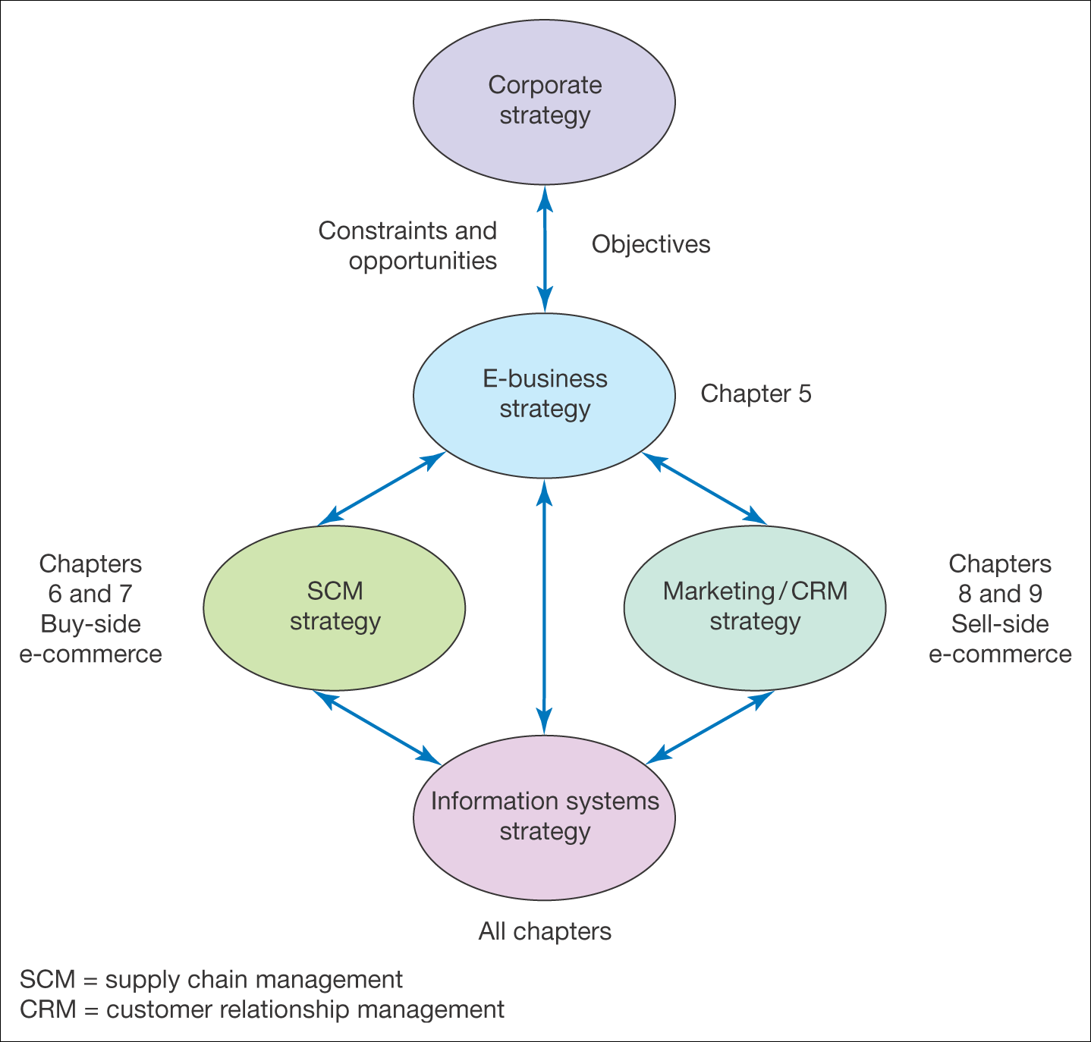
Figure 5.2 Relationship between e-business strategy and other strategies

Slide 16
corporate strategy which is concerned with the overall purpose and scope of the organization,
E-business strategy Definition of the approach by which applications of internal and external Electronic communications can support and influence corporate strategy.
Supply chain management is essentially the optimization of material flows and associated information flows involved with an Organization’s operations. To manage these material and information flows in e-business applications are very essential.
E-CRM is: Applying – Internet and other digital technology… (web, e-mail, wireless, iTV, databases)
To – acquire and retain customers (through a multi-channel buying process and customer lifecycle)
By – Improving customer knowledge, targeting, service delivery and satisfaction.
Information systems strategy should use a combination of impact and alignment techniques to govern e-business strategy.
  IS strategy can take a number of perspectives, of which those that focus on information or knowledge management and technological and applications infrastructure are most important.
Notes:
Electronic Customer Relationship Management (E-CRM)

Slide 17
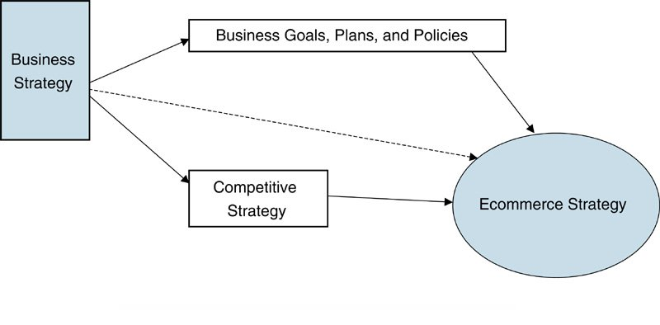
Business and E-commerce Strategy
E-commerce has changed business strategy.
A strategy is a broad-based formula for how a business is going to compete, what its goals should be, and what plans and policies will be needed to carry out those goals.¹
¹Michael Porter “What is Strategy”, Harvard Business Review, November 1996, pp. 69-84.

Slide 18
E-commerce Strategy
An e-commerce strategy is a …
To build an e-commerce strategy requires two view of an organization’s strategy: what it wants to do (conceptual) and how it will do it (technology strategy).
One strategy being used by many companies is customer relationship management which enables them to create to one-to-one marketing experience for their customers.
Other e-commerce strategies include virtual showrooms, increased channel choices, wider component choice, and use of mobile technology.

Slide 19
E-commerce Business Models (cont.)¹
Business Model | Description | Examples | Comments
Brokerage | Brokers bring buyers and sellers together for a fee. |  | There are many types of brokerage models in all types of e-commerce.
Advertising | An extension of the traditional media broadcasting model in which ads appear on Web sites. |  | There are many different types of advertising, but all depend on a large volume of viewer traffic.
Merchant | Sell products, both physical and electronic, to consumers |  | Commonly referred to as e-tailers, merchants can use pure e-commerce or a combination (click and mortar).
¹Adapted from Micheal Rappa, http://digitalenterprise.org/models/models.html.

Slide 20
E-commerce Business Models (cont.)¹
Business Model | Description | Examples | Comments
Manufacturer Direct | Make and sell products directly to customer |  | Products can be purchased (PCs), leased (servers), or licensed (software).
Affiliate | Affiliate Web sites are paid a fee when purchases come through them. |  | Can also include banner ad exchange between affiliated sites as well as revenue-sharing.
Community | Based on user loyalty because of high investment of time and emotion. |  | Revenue is generated through sale of ancillary products or voluntary contributions
¹Adapted from Micheal Rappa, http://digitalenterprise.org/models/models.html.

Slide 21
E-commerce Business Models (cont.)¹
Business Model | Description | Examples | Comments
Subscription | Users are charged fee to subscribe to service to service or information source |  | Subscription may be for premium services; advertising model may be combined with this model
Infomediary | Provides data on consumers and consumption habits |  | Usually aimed at helping businesses rather than consumers
Coopetitive | Enable competitors to cooperate on a Web site |  | Usually aimed at individuals or small businesses that cannot attract customers to their own Web site.
¹Adapted from Micheal Rappa, http://digitalenterprise.org/models/models.html.

Slide 22
Web Sites Classified By Purpose
Web Site Type | Purpose | Example | Business Model
Portal | A gateway to many other Web sites |  | Advertising, Affiliate
Search Engine | Finds Web sites that contain a word or phrase |  | Advertising, Affiliate, Infomediary
Browse or search and buy | Sell goods and services |  | Merchant, Infomediary, Manufacturer Direct, Coopetitive
Sales Support | To provide information on a product before or after the sale |  | Community, Infomediary

Slide 23
Web Sites Classified By Purpose (Cont.)
Web Site Type | Purpose | Example | Business Model
Information Service | To provide news, information, commentary, and so on. |  | Subscription, Community, Affiliate
Auction | Facilitate sales between third parties |  | Brokerage
Travel | Sell travel tickets and tours |  | Merchant, Brokerage, Coopetitive
Special Interest or Services | Provide information, product sales and support, and contacts between visitors |  | Community, Merchant, Affiliate, Infomediary, Advertising

Slide 24
B2B Business Models
Strategic sourcing is often carried out through a one-to-one business model, but company-centric and exchange models are also used.
The single company dominates the market and controls the information systems that supports the transactions. Electronic data interchange (EDI) or an extranet is often used to link trading partners.

Slide 25
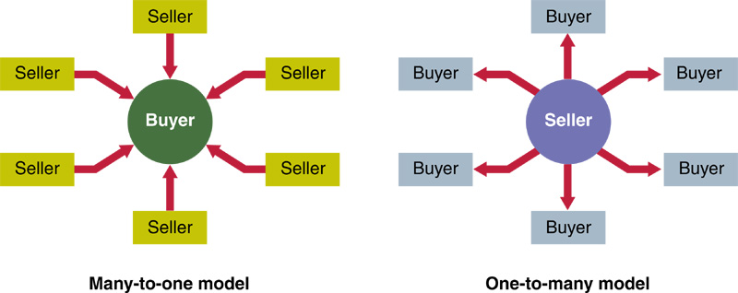
Company Centric Business Model

Slide 26
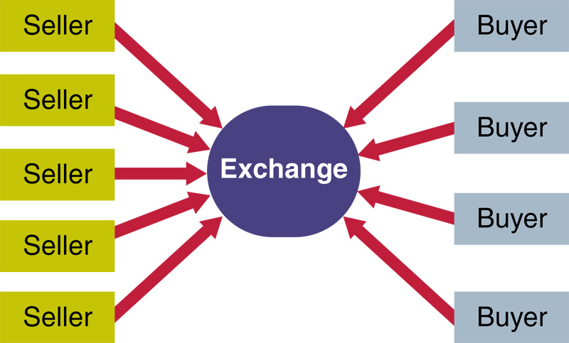
Exchange Model
In the exchange business model, many companies use an exchange to buy and sell from each other through spot-buying transactions.

Slide 27
Mobile Commerce
Mobile commerce (m-commerce) relies on the use of wireless devices, such as personal digital assistants, cell phones, and smart phones, to place orders and conduct business
Issues confronting m-commerce
  User-friendliness of the wireless device
  Network speed
  Security

Slide 28
What happens where there is no e-business strategy?
Missed opportunities for additional sales on the sell-side and more efficient purchasing on the buy-side
Fall-behind competitors in delivering online services – may become difficult to catch-up, e.g. Tesco, Dell
Poor customer experience from poorly integrated channels.

Slide 29
Electronic Payment Systems
Digital certificate: an attachment to an e-mail message or data embedded in a Web page that verifies the identity of a sender or a Web site
Certificate authority (CA): a trusted third party that issues digital certificates
Secure Sockets Layer (SSL): a communications protocol used to secure sensitive data
Electronic cash: an amount of money that is computerized, stored, and used as cash for e-commerce transactions

Slide 30
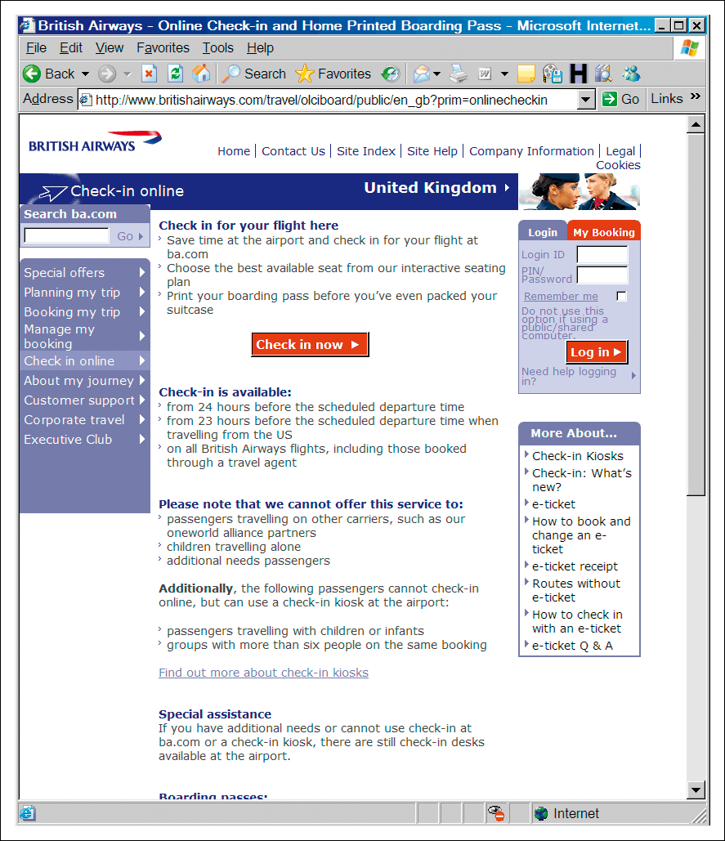
Figure 5.3 BA communicates their online value proposition (www.britishairways.com)
Source: Based on Revolution (2005)

Slide 31
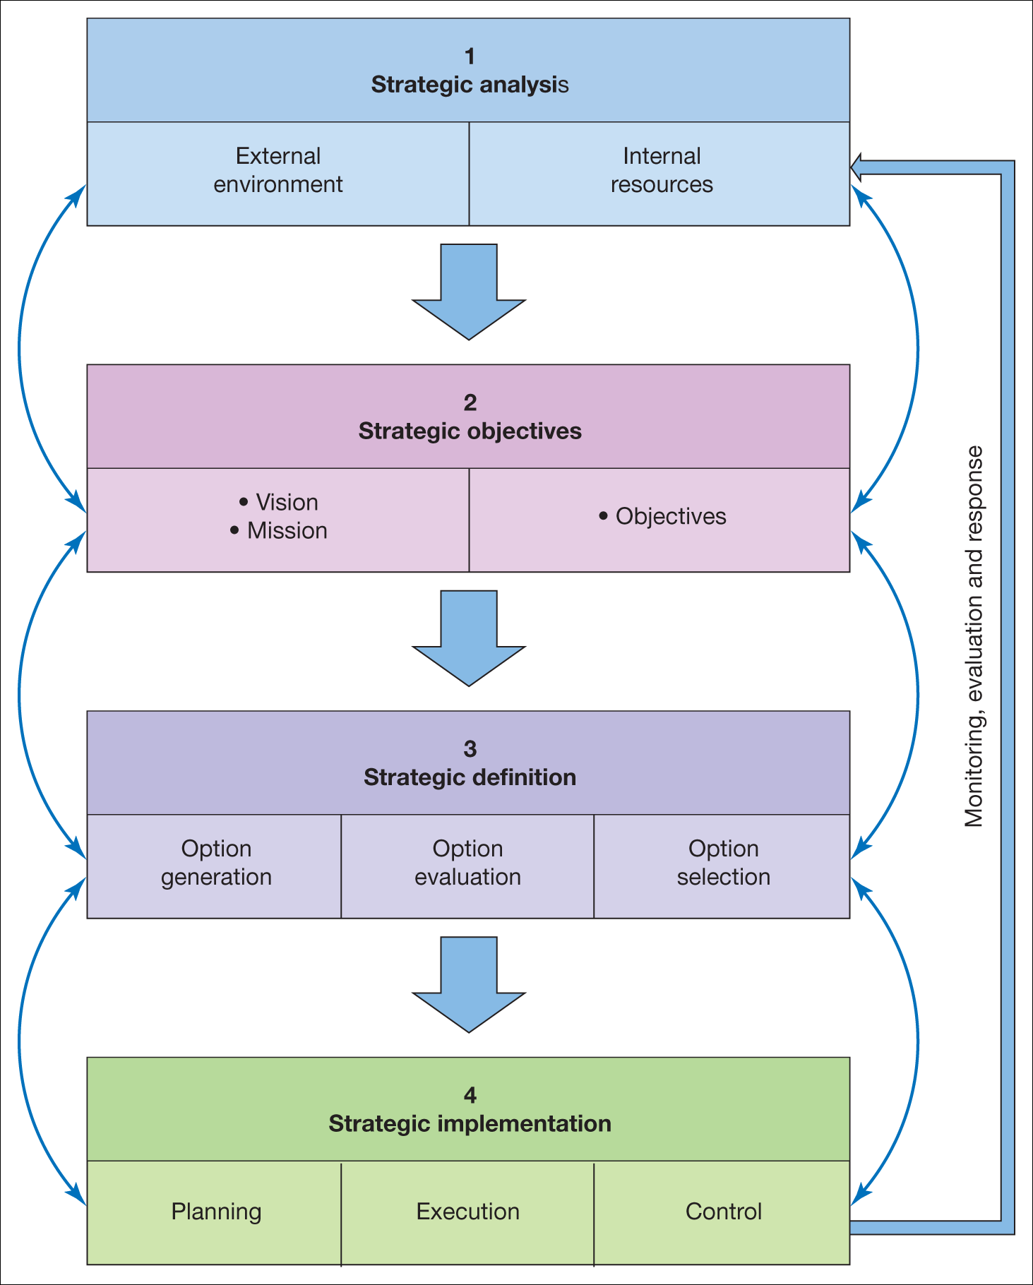
Figure 5.4 A generic strategy process model

Slide 32
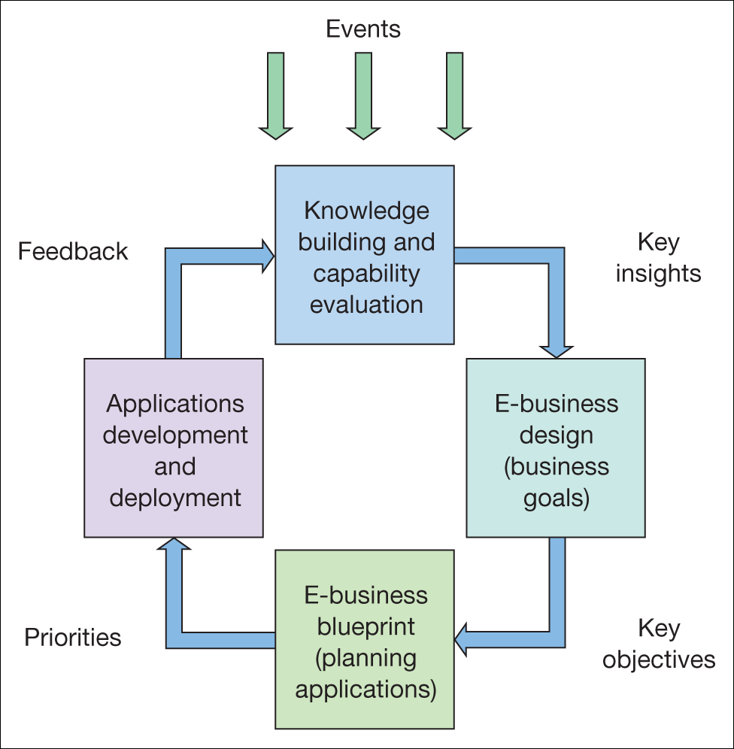
Figure 5.5 Dynamic e-business strategy model
Source: Adapted from description in Kalakota and Robinson (2000)

Slide 33
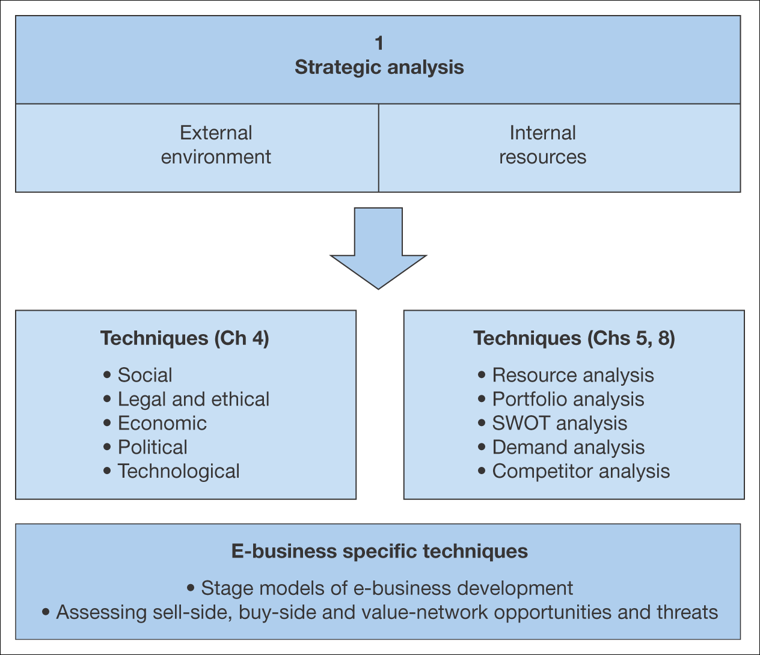
Figure 5.6 Elements of strategic situation analysis for the e-business

Slide 34
E-consultancy (2008a) uses a form of portfolio analysis as the basis for benchmarking current e-commerce capabilities and identifying strategic priorities.
The six areas for benchmarking are:
1 Digital channel strategy. The development of a clear strategy including situation analysis, goal setting, identification of key target markets and audience and identification of priorities for development of online services .
2.Online customer acquisition. Strategies for gaining new customers online using alternative digital media channels , including search engine marketing, partner marketing and display advertising.
3 Online customer conversion and experience. Approaches to improve online service levels and increase conversion to sales or other online outcomes.
Figure 5.7 Summary applications of a portfolio analysis for The B2B Company

Slide 35
4 Customer development and growth. Strategies to encourage visitors and customers to continue using online services using tactics such as e-mail marketing and personalization.
5 Cross-channel integration and brand development. Integrating online sales and service with customer communications and service interactions in physical channels such as traditional advertising, phone and in-store touchpoints.
6 Digital channel governance. Issues in managing e-commerce services such as structure and resourcing including human resources and the technology infrastructure such as hardware and networking facilities to deliver these applications.
Figure 5.7 Summary applications of a portfolio analysis for The B2B Company

Slide 36
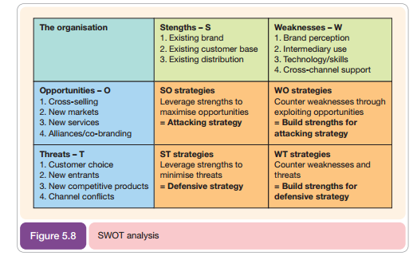
Figure 5.8 SWOT analysis for The B2B Company

Slide 37
SWOT analysis for The B2B Company
SWOT analysis is a relatively simple yet powerful tool that can help organizations analyze their internal resources in terms of strengths and weaknesses and match them against the external environment in terms of opportunities and threats.
In an e-business context, a SWOT analysis of e-business-specific issues can combine SWOT related to corporate, marketing, supply chain and information systems, or a separate SWOT can be performed for each.
SWOT analysis is of greatest value when it is used not only to analyze the current situation, but also as a tool to formulate strategies.
To achieve this it is useful once the strengths, weaknesses, opportunities and threats have been listed to combine them as shown in Figure 5.8.
This format of SWOT is recommended over a typical four-box SWOT since it can be used to develop strategies to counter the threats and take advantage of the opportunities and can then be built into the e-business strategy

Slide 38
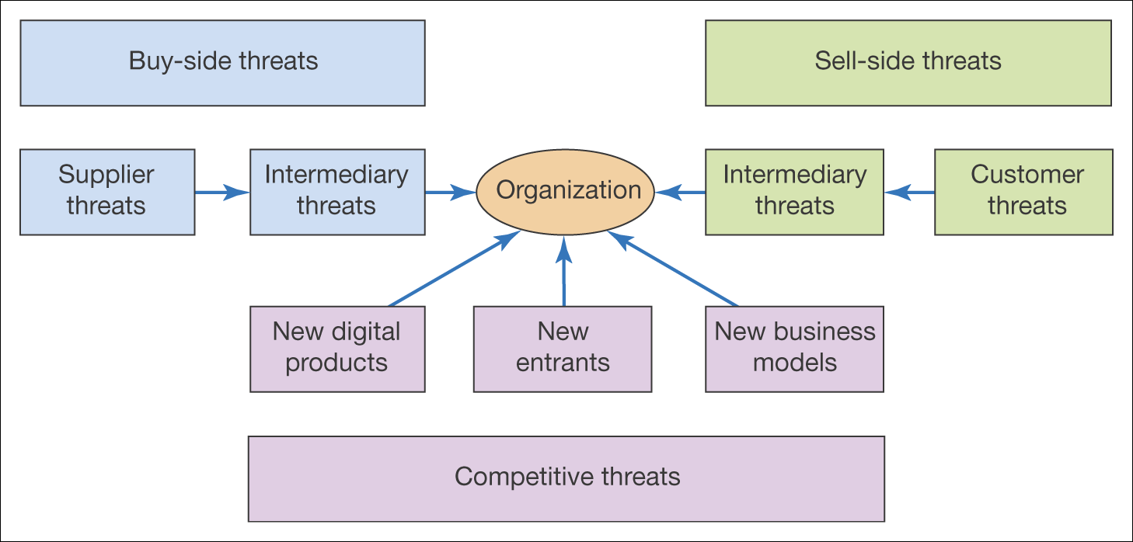
Figure 5.10 Competitive threats acting on the e-business

Slide 39
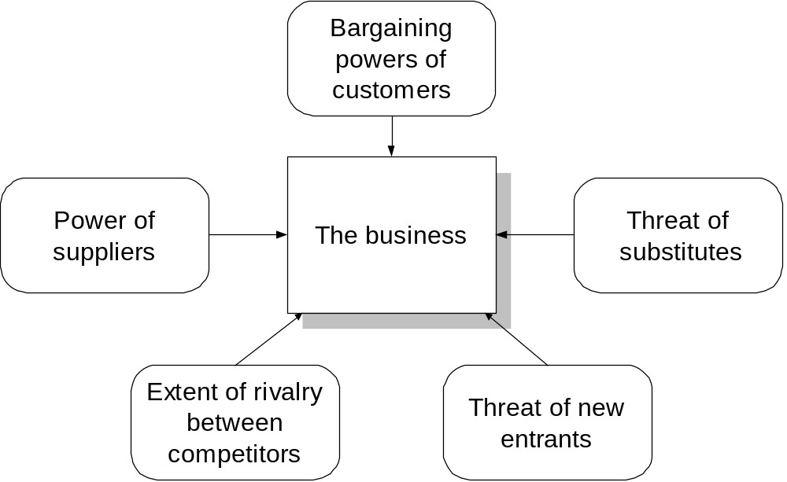
Porter’s five forces

Slide 40
Activity – impact of Internet
For one of the industries below, assess how the Internet has changed the competitive forces, e.g. has it increased or decreased power of suppliers and customers
Industries:
  Banking
  Supermarkets
How can e-business create business value?
As Chaffey and Wood (2004) have emphasized, much of the organizational value created by e-business is due to more effective use of information. The strategic importance of business information management in an organization can be reviewed and communicated as part of vision using Figure 5.12.
This analytic tool, devised by Professor Don Marchand, shows different ways in which information can create value for organizations

Slide 41
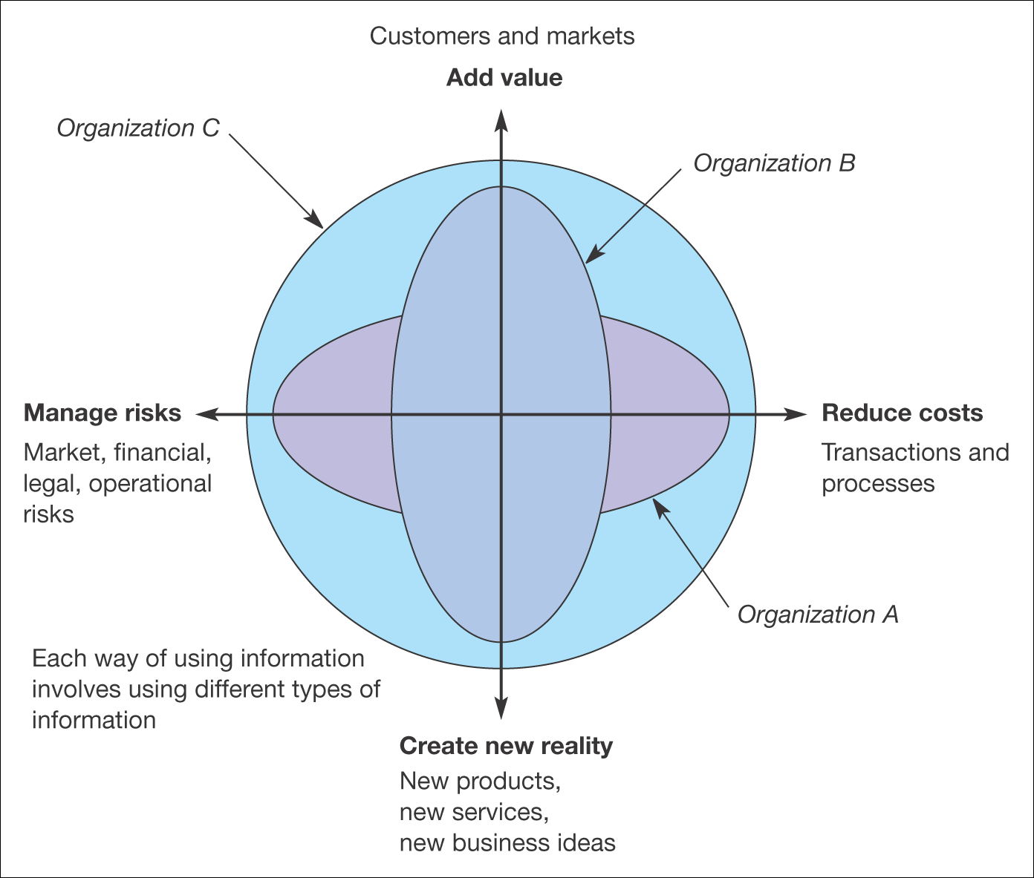
Figure 5.12 An evaluation tool relating information to business value. An organization’s use of information on each axis can be assessed from 1 (low use
of information) to 10 (high use of information)
Source: Marchand et al. eds (1999)

Slide 42
The balanced scorecard approach to objective setting Integrated metrics such as the balanced scorecard have become widely used as a means of translating organizational strategies into objectives and then providing metrics to monitor the execution of the strategy. Since the balanced business scorecard is a well-known and widely used framework, it can be helpful to define objectives for e-business in the categories below
1 Customer concerns. These include time (lead time, time to quote, etc.), quality, performance, service and cost. Example measures from Halifax Bank from Olve et al. (1999): satisfaction of mystery shoppers visiting branches and from branch customer surveys.
2 Internal measures. Internal measures should be based on the business processes that have the greatest impact on customer satisfaction: cycle time, quality, employee skills, productivity
3 Financial measures. Traditional measures such as turnover, costs, profitability and return on capital employed. For publicly quoted companies this measure is key to shareholder value. Example measures from Halifax Bank: gross receipts (£), mortgage offers (£), loans (£).
4 Learning and growth: innovation and staff development. Innovation can be measured by change in value through time (employee value, shareholder value, percentage and value of sales from new products). E

Slide 43
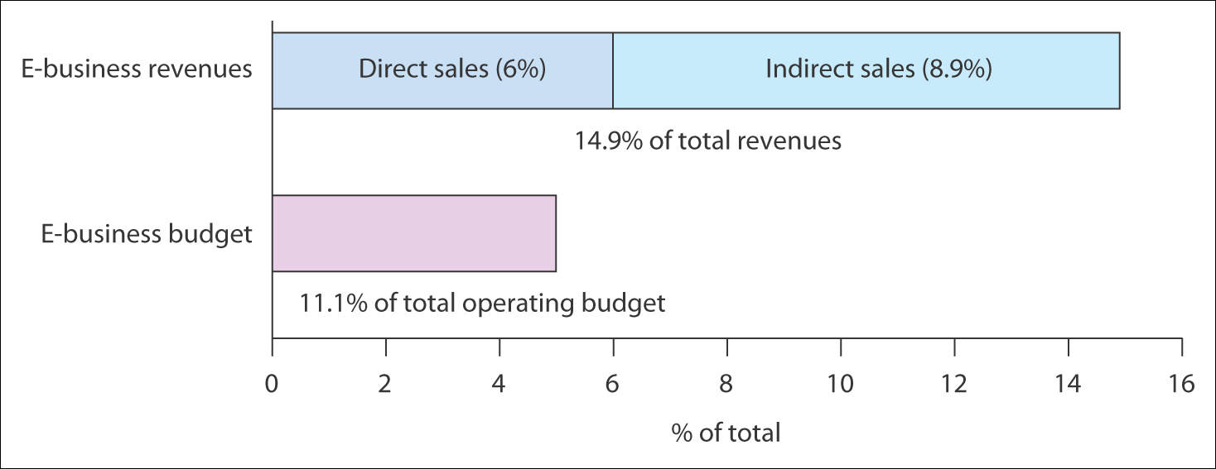
Figure 5.14 Direct and indirect Internet contributions for fast-growth companies in
the USA
Source: PricewaterhouseCoopers (2000)

Slide 44
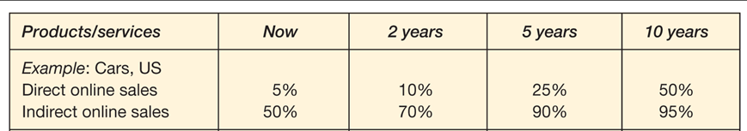
Table 5.5 Vision of online revenue contribution for The B2B Company

Slide 45
Supply Chain Management
What is supply chain management?
Options for restructuring the supply chain
Using e-business to restructure the supply chain
Supply chain management implementation

Slide 46
The issues for the manager:
Which technologies should we deploy for supply chain management and how should they be prioritized?
Which elements of the supply chain should be managed within and beyond the organization and how can technology be used to facilitate this?
What are the practical issues with online supply chain management?

Slide 47
SCM
Supply chain management is essentially the optimization of material flows and associated information flows involved with an Organization’s operations.
To manage these material and information flows in e-business applications are very essential
Supply chain management capabilities are best known for their importance in delivering profitability.
For example AMR (2008) reported that Nike, a company best known for its marketing, used improvements to its supply chain to increase operating margins of between 10 and 15% in each of the last four years.

Slide 48
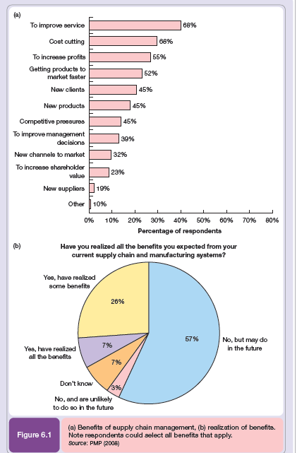

Slide 49
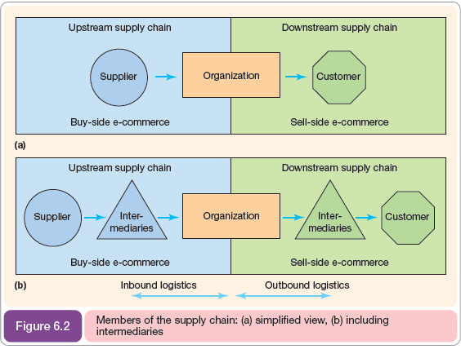

Slide 50
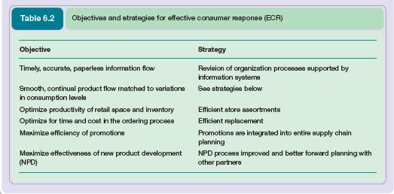

Slide 51
SCM in 3 phases
1 Early implementation: 1989–93. This was a PC-based EDI purchasing system. At this stage, objectives were to
reduce data errors to 0,
reduce administration costs,
improve management control,
reduce order lead time.
Benefits of this phase included rationalization of suppliers to 12 major partnerships (accounting for 60% of invoices); 80% of invoices placed electronically by 1990; 7,000 items were eliminated from the warehouse, to be sourced directly from suppliers, on demand. Shorter lead times in the day-to-day process – from 10 days to 26 hours for items supplied through a standard contract and from 42 days to 10 days for direct-purchase items. At this stage the main barriers to the implementation were technological.
2 Electronic trading gateway: 1990–4. This was again EDI-based, but involved a wider range of parties both externally (from suppliers through to customers) and internally (from marketing, sales, finance, purchasing and legal).
The aim was to provide a combined upstream and downstream supply chain solution to bring benefits to all parties. The main learning from this process was the difficulty of getting customers involved – only four were involved after 4 years, although an industry-standard method for data exchange was used.
This was surprising since suppliers had been enthusiastic adopters. From 1994, there was no further uptake of this system.

Slide 52
What is logistics?
Logistics is a concept closely related to supply chain management. According to the Institute of Logistics and Transportation (www.iolt.org):
Logistics is the time-related positioning of resource, or the strategic management of the total supply chain.
The supply chain is a sequence of events intended to satisfy a customer. It can include procurement, manufacture, distribution, and waste disposal, together with associated transport, storage and information technology.
This definition of logistics is broad, reflecting its provenance.More typically, logistics is used to refer not to all supply chain activities, but specifically to the management of logistics or inbound and outbound logistics, (Figure 6.2).
Logistics is essential to the efficient management of the supply chain, for example resource management and transport are integral parts of the supply chain, not only between supply chain processes, but within these processes.

Slide 53
Push and pull supply chain models
A change in supply chain thinking, and also in marketing communications thinking, is the
move from push models of selling to pull models or to combined push–pull approaches.
The push model is illustrated by a manufacturer who perhaps develops an innovative product and then identifies a suitable target market.
A distribution channel is then created to push the product to the market. This situation is shown in Figure 6.7(a) where it can be characterized by the sentence ‘This is a great product, now who shall we sell it to?’ or the quip about the original Model T Ford – ‘You can have any colour, so long as it is black.’
The typical motivation for a push approach is to optimize the production process for cost and efficiency.

Slide 54
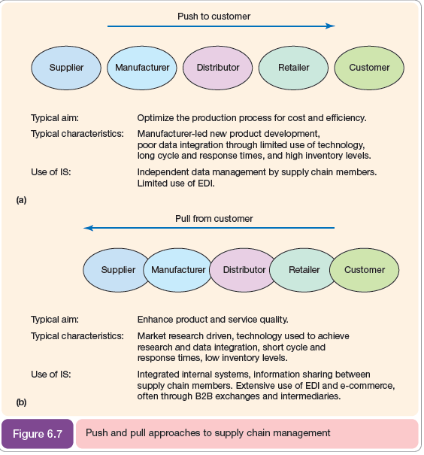

Slide 55
value chain (VC)
Michael Porter’s value chain (VC) is a well-established concept for considering key activities that an organization can perform or manage with the intention of adding value for the customer as products and services move from conception to delivery to the customer (Porter, 1980).
The value chain is a model that describes different value-adding activities that connect a company’s supply side with its demand side.
We can identify an internal value chain within the boundaries of an organization and an external value chain where activities are performed by partners.
By analyzing the different parts of the value chain managers can redesign internal and external processes to improve their efficiency and effectiveness. Benefits for the customer are created by reducing cost and adding value to customers:
within each element of the value chain such as procurement, manufacture, sales and distribution; at the interface between elements of the value chain such as between sales and distribution.
In equation form this is:
Value = (Benefit of each VC activity – Its cost) + (Benefit of each interface between VC activities
– Its cost)

Slide 56
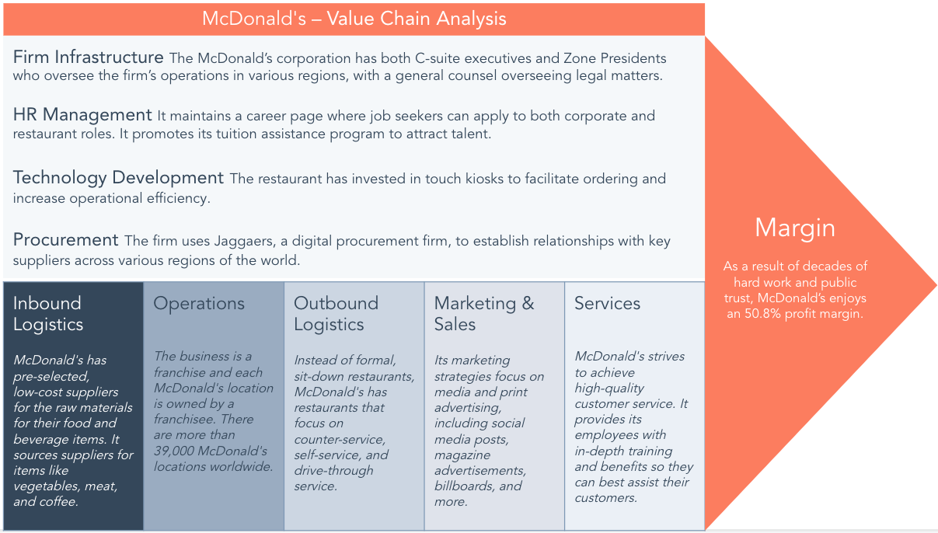

Slide 57
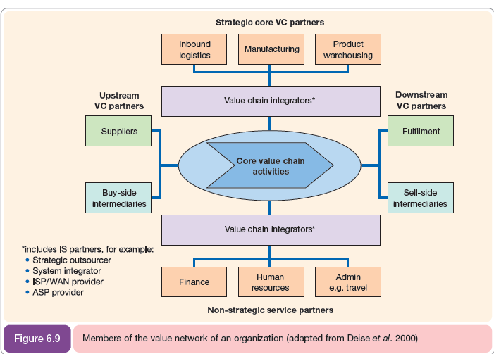

Slide 58
Value networks
Figure 6.9, which is adapted from the model of Deise et al. (2000), shows some of the
partners of a value network that characterizes partners as:
1 Supply-side partners (upstream supply chain) such as suppliers, business-to-business
exchanges, wholesalers and distributors.
2 Partners that fulfill primary or core value chain activities. The number of core value chain
activities that will have been outsourced to third parties will vary with different companies
and the degree of virtualization of the organization.
In some companies the management of inbound logistics may be outsourced, in others different aspects of the manufacturing process. In the virtual organization all core activities may be outsourced.
3 Sell-side partners (downstream supply chain) such as business-to-business exchanges,
wholesalers, distributors and customers (not shown, since conceived as distinct from other
partners)

Slide 59
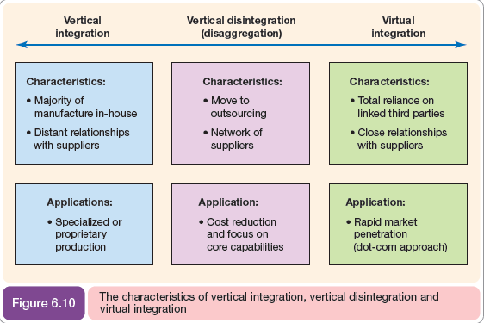

Slide 60
Benefits of e-supply chain management
Given, the relative lack of adoption of e-SCM, particularly in SMEs, which opportunities are being missed that are available to adopters? E-business can be used to improve supply chain management in a number of ways.
These are illustrated well by research by IDC (2004) into the challenges facing manufacturers in one sector (electronic component manufacture).
This research showed that their main challenges (scored out of 5) were:
Reduce order-to-delivery time (4.3)
Reduce costs of manufacturing (4.1)
Manage inventory more effectively (4.0)
Improve demand forecasting (3.9)
Reduce time to introduce new products (3.7)
Improve after-market/post-sales operations (3.2

Slide 61
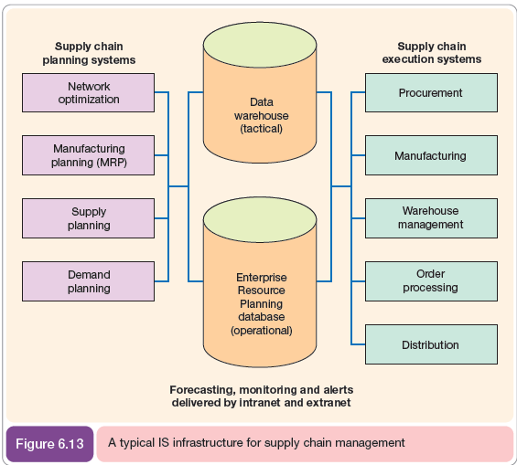

Slide 62
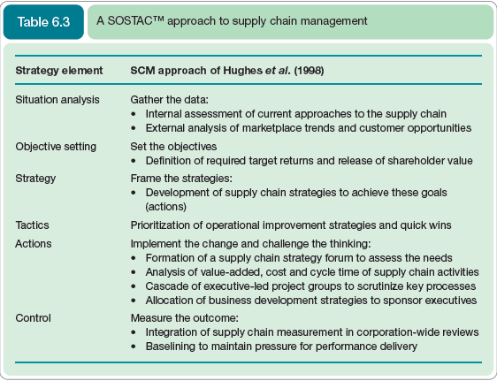

Slide 63
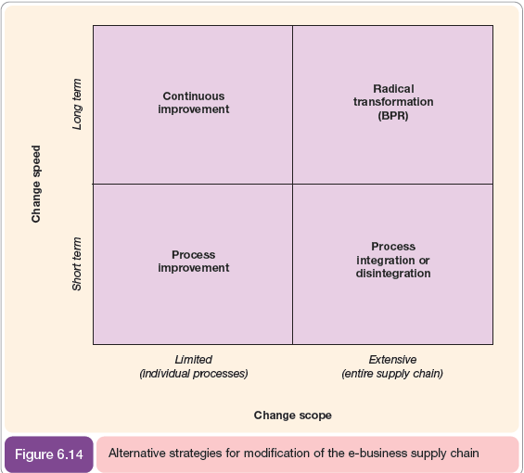

Slide 64
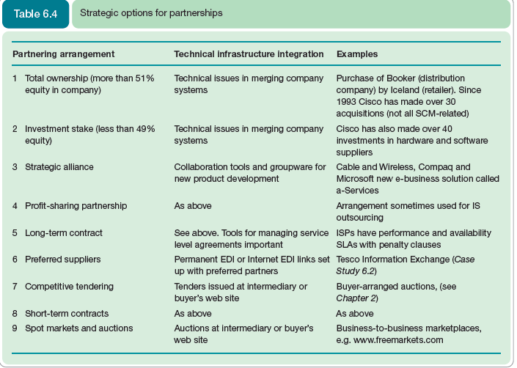

Slide 65
Managing global distribution
Arnold (2000) suggests action that manufacturers should follow as they enter new overseas markets enabled by the Internet. The seven actions are:
1 Select distributors. Do not let them select you.
2 Look for distributors capable of developing markets rather than those with new customer contacts.
3 Treat the local distributors as long-term partners, not temporary market entry vehicles.
4 Support market entry by committing money, managers and proven marketing ideas.
5 From the start, maintain control over marketing strategy.
6 Make sure distributors provide you with detailed market and financial performance data.
7 Build links among national distributors at the earliest opportunity

Slide 66
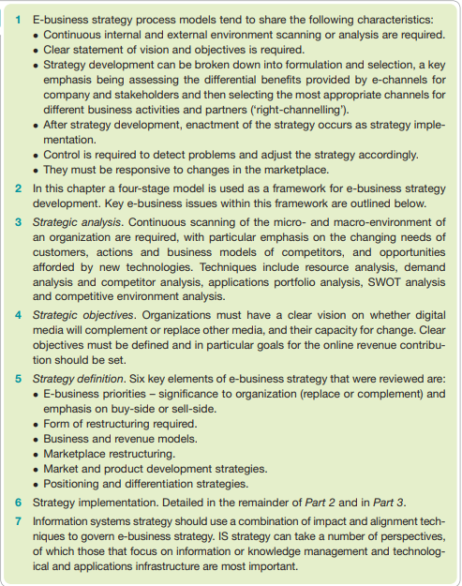
Summary

